Slide 1
OPERATING SYSTEM OBJECTIVES AND FUNCTIONS

Slide 2
TOPICS TO BE COVERED
Introduction to OS
Computer system organization
OS Objectives and Functions
OS Services
Evolution of OS
System calls
Types of System calls

Slide 3
INTRODUCTION TO OS

Slide 4
WHAT IS AN OPERATING SYSTEM?
A program that acts as an intermediary between a user of a computer and the computer hardware
Operating system goals:
Execute user programs and make solving user problems easier
Make the computer system convenient to use
Use the computer hardware in an efficient manner

Slide 5
COMPUTER SYSTEM STRUCTURE
Computer system can be divided into four components:
Hardware – provides basic computing resources
CPU, memory, I/O devices
Operating system
Controls and coordinates use of hardware among various applications and users
Application programs – define the ways in which the system resources are used to solve the computing problems of the users
Word processors, compilers, web browsers, database systems, video games
Users
People, machines, other computers

Slide 6
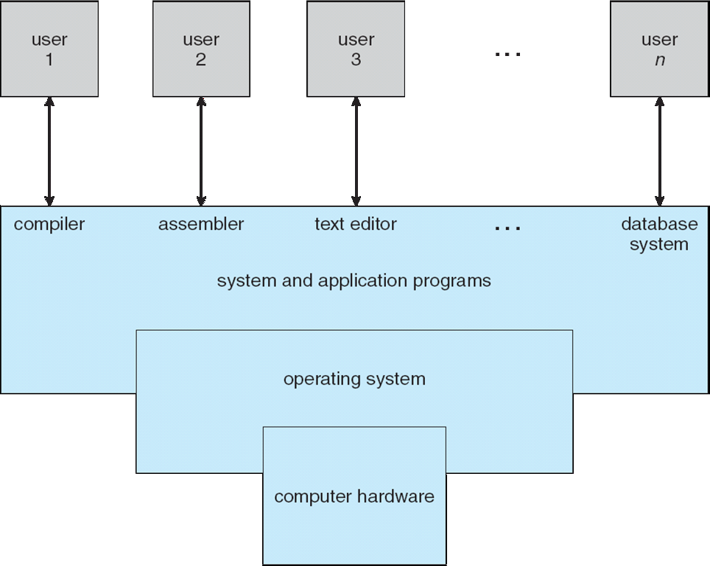
FOUR COMPONENTS OF A COMPUTER SYSTEM

Slide 7
WHAT OPERATING SYSTEMS DO
Depends on the point of view
User’s view and System’s view
Users want convenience, ease of use
Don’t care about resource utilization
But shared computer such as mainframe or minicomputer must keep all users happy
Users of dedicate systems such as workstations have dedicated resources but frequently use shared resources from servers
Handheld computers are resource poor, optimized for usability and battery life
Some computers have little or no user interface, such as embedded computers in devices and automobiles

Slide 8
OPERATING SYSTEM DEFINITION
OS is a resource allocator
Manages all resources
Decides between conflicting requests for efficient and fair resource use
OS is a control program
Controls execution of programs to prevent errors and improper use of the computer

Slide 9
OPERATING SYSTEM DEFINITION (CONT.)
No universally accepted definition
“Everything a vendor ships when you order an operating system” is good approximation
But varies wildly
“The one program running at all times on the computer” is the kernel. Everything else is either a system program (ships with the operating system) or an application program.

Slide 10
WHY STUDY OPERATING SYSTEM?
Abstraction: gives users the illusion of infinite resources (CPU time, memory, file space)?
System design: tradeoffs between
Performance and convenience of these abstractions
Performance and simplicity of OS
Functionality in hardware or software
Primary intersection point: OS is the point where hardware, software, programming languages, data structures, and algorithms all come together

Slide 11
COMPUTER SYSTEM ORGANIZATION
Computer System operation
Storage structure
Input output structure

Slide 12
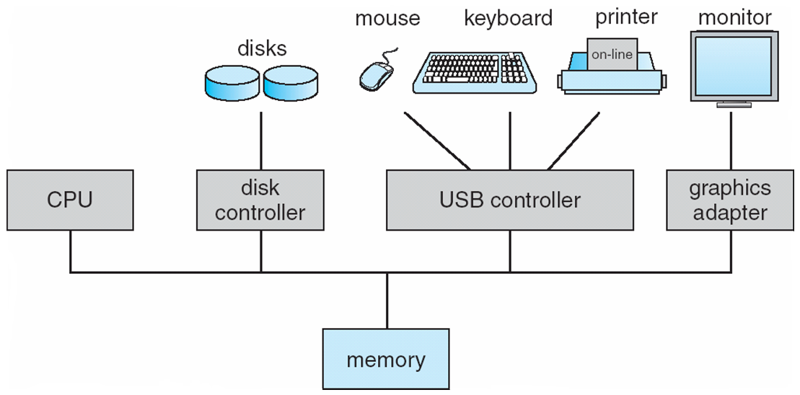
COMPUTER SYSTEM OPERATION
Computer-system operation
One or more CPUs, device controllers connect through common bus providing access to shared memory
Concurrent execution of CPUs and devices competing for memory cycles
Memory controller synchronizes access to memory

Slide 13
COMPUTER STARTUP
bootstrap program is loaded at power-up or reboot – initializes all aspects of system
Typically stored in ROM or EPROM- known as firmware
Loads operating system kernel and starts execution
System process or daemons run the entire time the kernel is running
Occurrence of an event is signaled by interrupt
Interrupts can be hardware or software

Slide 14
COMMON FUNCTIONS OF INTERRUPTS
Interrupt is an event external to the currently executing process that causes a change in the normal flow of instruction execution.
Possible solutions for checking Interrupts
Polling :CPU periodically checks each device to see if it needs service
Interrupt: Interrupt line is used to signal the processor. Interrupt handler is used to deal with interrupts.

Slide 15
HOW INTERRUPTS ARE HANDLED
The operating system preserves the state of the CPU in registers and by using program counter
Different interrupts have different segments of code to be executed.
The interrupt architecture stores the return address on the system stack.
After the interrupt is serviced, the saved return address is loaded into the program counter and the interrupted computation resumes as though interrupt has not yet occurred.

Slide 16
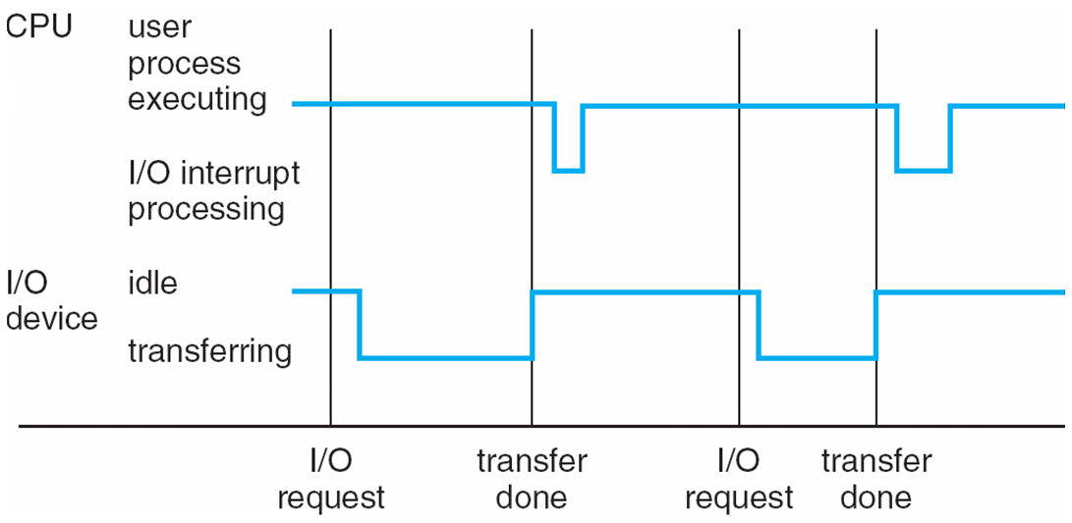
INTERRUPT TIMELINE

Slide 17
STORAGE STRUCTURES
Any program to run should be stored in main memory
This main memory also called as Random Access Memory (RAM) is implemented using a semi conductor technology called as Dynamic RAM
Read Only Memory(ROM) stores static programs such as bootstrap program
EEPROM(Electrically Erasable Programmable Read Only Memory) is used in smart phones -factory installed programs

Slide 18
STORAGE STRUCTURE
RAM is volatile
Secondary storage – extension of main memory that provides large nonvolatile storage capacity
Magnetic disks – rigid metal or glass platters covered with magnetic recording material
Disk surface is logically divided into tracks, which are subdivided into sectors
The disk controller determines the logical interaction between the device and the computer

Slide 19
STORAGE HIERARCHY
Storage systems organized in hierarchy
Speed
Cost
Volatility
Caching – copying information into faster storage system; main memory can be viewed as a cache for secondary storage
Why secondary storage is required?

Slide 20
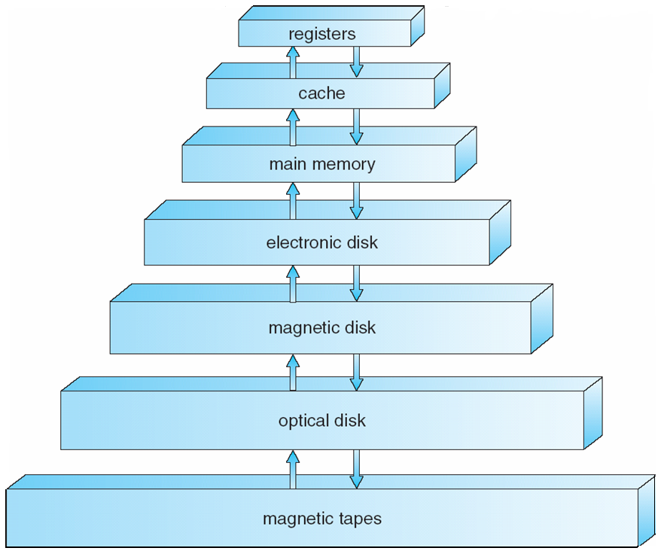
STORAGE-DEVICE HIERARCHY

Slide 21
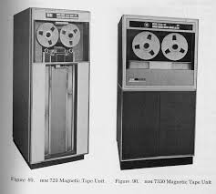
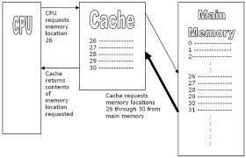
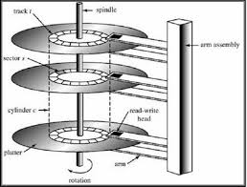
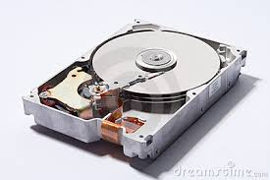

Slide 22
CACHING
Information in use copied from slower to faster storage temporarily
Faster storage (cache) checked first to determine if information is there
If it is, information used directly from the cache (fast)
If not, data copied to cache and used there
Cache smaller than storage being cached
Cache management important design problem
Cache size and replacement policy

Slide 23
I/O STRUCTURE
Devices are attached to small computer systems interface (SCSI) controller
Devices are controlled by Device Controller and OS maintains Device Driver for each.

Slide 24
WORKING OF DEVICE CONTROLLER
Device Controller
Device
Driver
Registers
Local Buffers
For bulk data movement Direct Memory Access(DMA) is used

Slide 25
SUMMING UP
Computer system organization
Computer operation/ interrupts
Storage/RAM/ROM/Secondary Storage devices
I/O operations-Device controllers/ drivers/Direct Memory Access

Slide 26
QUIZ
I can store data permanently. Who am I?
_______
2. I can store more data and I am comparatively cheaper. Who am I? ___________
3. Occurrence of an event is signaled by me? I am _______________
4. Secondary Storage is required because main memory is ___________

Slide 27
OS OBJECTIVES AND FUNCTIONS
OS is a layer of software whose job is to manage all devices and provide user programs with a simpler interface to the hardware
Objectives of OS
Convenience
Efficiency
Ability to evolve
Notes:
‹#›

Slide 28
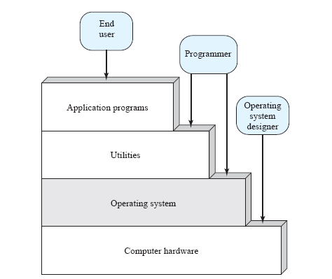
LAYERS AND VIEWS OF COMPUTER SYSTEM

Slide 29
LAYERED APPROACH
End user views a computer system in terms of a set of applications
Applications are developed in a programming language and is developed by application programmer
To make the applications reachable to computer hardware system programs or utilities are provided
OS comprises of collection of system programs
OS masks the details of the hardware from the programmer and provides the programmer with a convenient interface for using the system.

Slide 30
OS AS USER/COMPUTER INTERFACE
OS provides services in the following areas:
Program Development- Editors/Debuggers assist programmer in creating programs. These are provided as application program development tool.
Program execution – load program-run program-execute program
Access to I/O devices - OS provides a uniform interface for I/O devices which are hidden from end users
Controlled Access to files - OS needs to understand I/O, structure of file and also provide protection to users in multiuser environment

Slide 31
OS AS USER/COMPUTER INTERFACE
System Access: Provide access to system as whole and to specific system resources. Resolve conflicts for resource contention.
Error detection – OS needs to be constantly aware of possible errors
May occur in the CPU and memory hardware, in I/O devices, in user program
For each type of error, OS should take the appropriate action to ensure correct and consistent computing
Debugging facilities can greatly enhance the user’s and programmer’s abilities to efficiently use the system
Accounting - To keep track of which users use how much and what kinds of computer resources

Slide 32
OS AS RESOURCE MANAGER
OS controls the basic functions of the computer like movement, storage, processing of data
But the control mechanism is unusual
OS functions as a ordinary computer software
OS relinquishes controls or regains control depending on the processor.
This control mechanism is not external but something internal

Slide 33
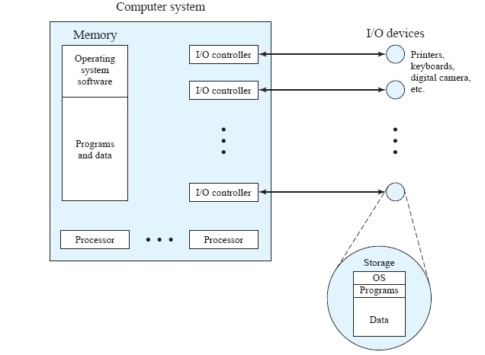
OS AS RESOURCE MANAGER CONTD…
kernel
Resources managed by the OS

Slide 34
OS AS RESOURCE MANAGER CONTD…
Resources the OS control are
Main memory
I/O devices and Files
Processor
OS controlling main memory
A portion of OS (Kernel) resides in the main memory
Kernel contain
Frequently used functions
Portions of OS which are currently in use
Main memory = Kernel + user programs + data
Main memory allocation is done by OS and memory management hardware in the processor

Slide 35
OS AS RESOURCE MANAGER CONTD…
OS controls I/O and files
Decides when an I/O can be used by a program in execution
Controlled access of files
OS controls the processor
Determines the processor time for the execution of a program

Slide 36
WHY OS EVOLVES?
Hardware upgrades plus new types of hardware
New services
Fixes: Faults are fixed and fixes are made. Fix introduces new faults
The need to change OS regularly places certain requirements on its design.
System should be modular in construction, with clearly defined interfaces between modulus and should be well documented

Slide 37
QUIZ
1 | System Programs | Fixes
2 | Debuggers | Resides in main memory
3 | Faults | Utilities
4 | Kernel | Application Program Development Tool

Slide 38
TOP 10 MOBILE PHONE OS
Name of Phone | OS | Updates if any
Nokia | Symbian | Symbian ANNA and BELLA
Samsung | Andriod | Jelly Bean
Iphone | Apple IOS
Black Berry | Black Berry OS | Blackberry OS 7.1
Nokia Lumia | Windows OS

Slide 39
Evolution of
operating systems

Slide 40
CONTENTS
Serial processing
Simple batch system
Multiprogrammed batch systems.
Time sharing Systems

Slide 41
SERIAL PROCESSING
No OS (late 1940-mid 1950)
Direct interaction with computer hardware
Programs in machine code were loaded via the input device (e.g., a card reader).
If an error halted the program, the error condition was indicated by the lights. If the program proceeded to a normal completion, the output appeared on the printer.

Slide 42
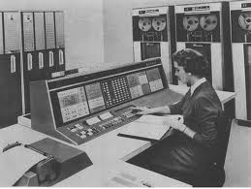
SERIAL PROCESSING

Slide 43
DRAWBACKS IN SERIAL PROCESSING
Scheduling:
Hardcopy sign up time to reserve computer time
Either processing time is wasted or user is unable to complete within the stipulated time period
Set up time: A single program, (job) could involve loading the compiler into memory, saving the compiled program (object program) and then loading and linking together the object program and common functions.
Each of these steps could involve mounting or dismounting tapes or setting up card decks.
If an error occurred, then the entire sequence had to be repeated. This resulted in time wastage.

Slide 44
SIMPLE BATCH SYSTEM
To improve processor utilization the concept of batch system was introduced
Developed in mid 1950s by General Motors
In these systems a type of OS called monitors were used.
The users submit their job in the form of cards to the computer operator
The computer operators sequentially places the entire job in the input device for use by the monitor

Slide 45
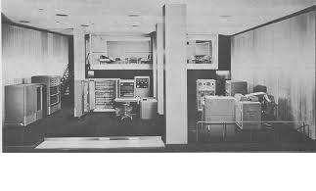
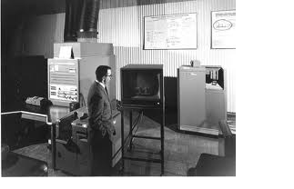
IBM 701
IBM 704

Slide 46
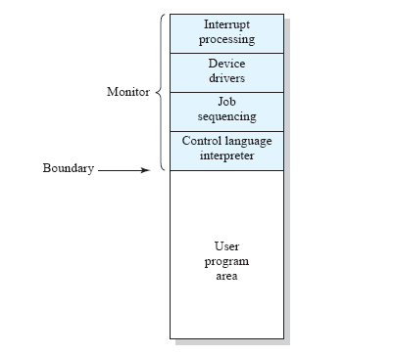
MEMORY LAYOUT BY A RESIDENT MONITOR

Slide 47
MONITOR POINT OF VIEW
A portion of monitor resides in the main memory (resident monitor)
The remaining portion resides in the utilities and subroutine
The resident monitor reads in the job from the input device
As it reads, it places the current job in the user area and control is passed on to this job
When job is completed it returns control to the monitor
The results of job is send to output device

Slide 48
PROCESSOR POINT OF VIEW
The processor is getting instructions either from the resident monitor or is executing instructions from the user area
Once a job in the user area is completed the control is passed to monitor which gives instruction for executing the next job
JCL(Job Control Language) is the language used of providing instructions to the monitor

Slide 49
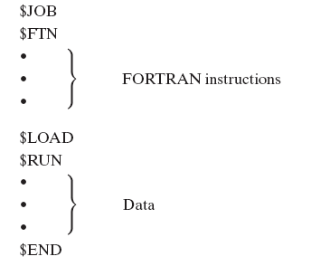

Slide 50
H/W FEATURES DESIRABLE FOR BATCH OS
Timer
Memory protection
Privileged instructions
*Interrupts
Modes of operation
User Mode
Kernel Mode
Advantages of Batch OS
Computer utilization increased
Disadvantages of Batch OS
1. Increased overhead- Some memory and processor time is given to the monitor

Slide 51
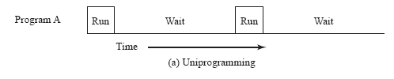
MULTIPROGRAMMED BATCH SYSTEMS
Problem with Batch OS processor is mostly idle because of waiting time of I/O devices.

Slide 52
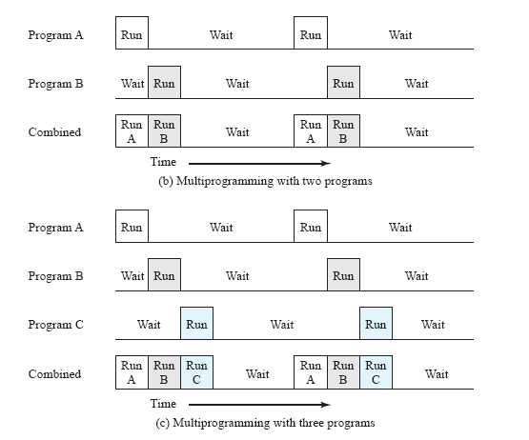
MULTIPROGRAMMED BATCH SYSTEMS CONTD…
More the number of programs the processor time is efficiently used up.
When memory can be expanded to accommodate more programs and switch between them multitasking or multiprogramming can be obtained

Slide 53
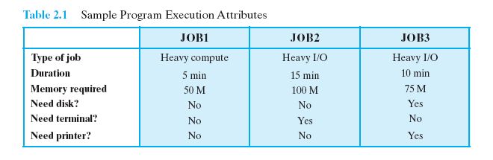
MULTIPROGRAMMED BATCH SYSTEMS CONTD…
Available memory: 256K words, disk, terminal, printer

Slide 54
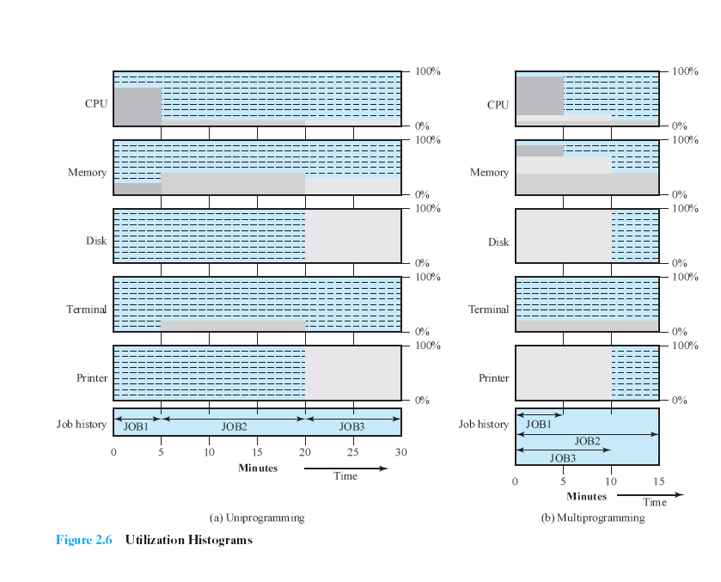

Slide 55
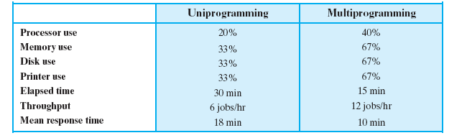

Slide 56
H/W FEATURES DESIRABLE FOR MULTIPROGRAMMED BATCH OS
I/O Interrupts and DMA(Direct Memory Access):- Give I/O command for one job and proceed with the execution of another job, where I/O is controlled by device controller
Memory management
Scheduling algorithms

Slide 57
TIME SHARING SYSTEMS
Though multiprogramming batch OS was very efficient certain transaction processing systems requires interactive mode.
In 1960s when personal computer was very costly the time sharing system came into existence
In a time-sharing system, multiple users simultaneously access the system through terminals, with the OS interleaving the execution of each user program in a short burst or quantum of computation.

Slide 58
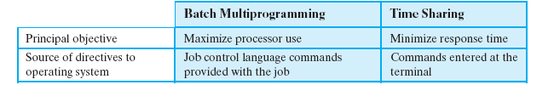
One of the first time-sharing operating systems to be developed was the
Compatible Time-Sharing System (CTSS) [CORB62], developed at MIT by a group known as Project MAC (Machine-Aided Cognition, or Multiple-Access Computers).

Slide 59
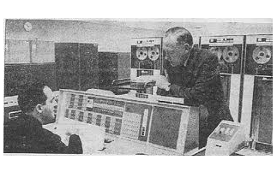
CTSS

Slide 60
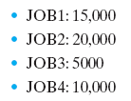
CTSS
The system ran on a computer with 32,000 36-bit words of main memory.
Resident Monitor - 5000
User’s program and data - loaded into the remaining 27,000 words of main memory.
A program was always loaded to start at the location of the 5000th word; this simplified both the monitor and memory management
System clock 0.2 sec

Slide 61
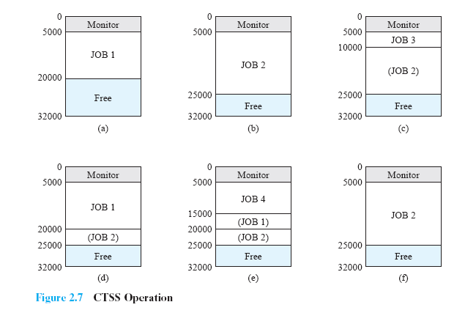
Job1:15000
Job2:20000
Job3:5000
Job4:10000

Slide 62
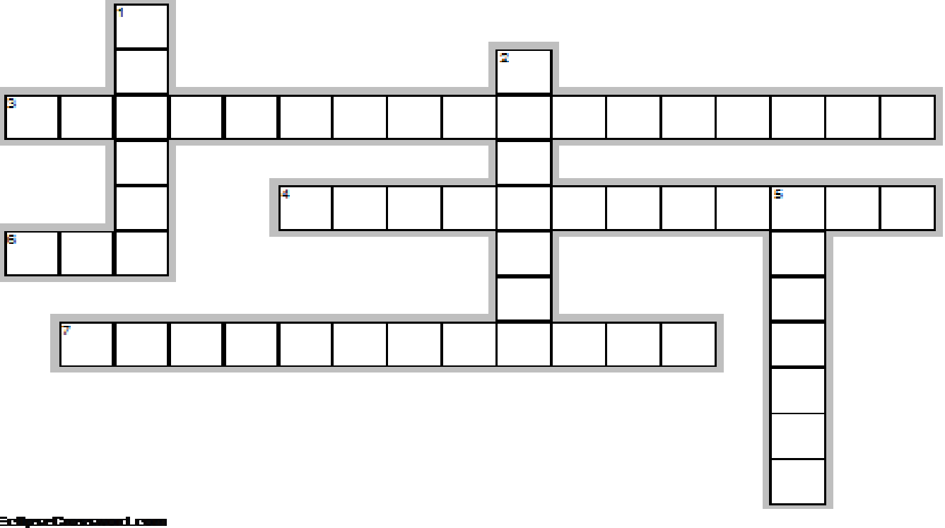
Across
3. hard copy sign up required (2 words)
4. memory can be expanded to accommodate more programs
6. language used for providing instructions to the monitor
7. mimimize response time (2 words)
Down
1. resides in memory
2. resident os
5. batch system (2 words)

Slide 63
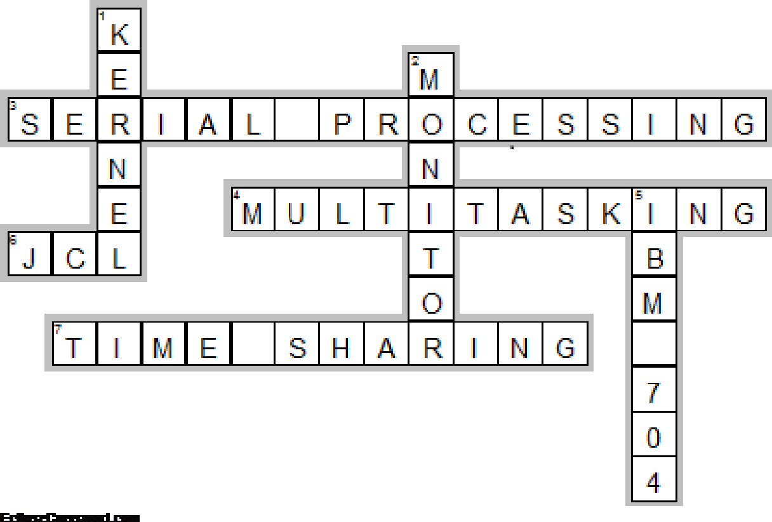

Slide 64
QUIZ
OS in a single user’s view is designed for
Ease of use
Resource utilization
OS in a mainframe is designed for
Ease of use
Resource utilization
In workstations the OS is designed for
Ease of use
Resource utilization
Compromise between ease and utilization

